Slide 1
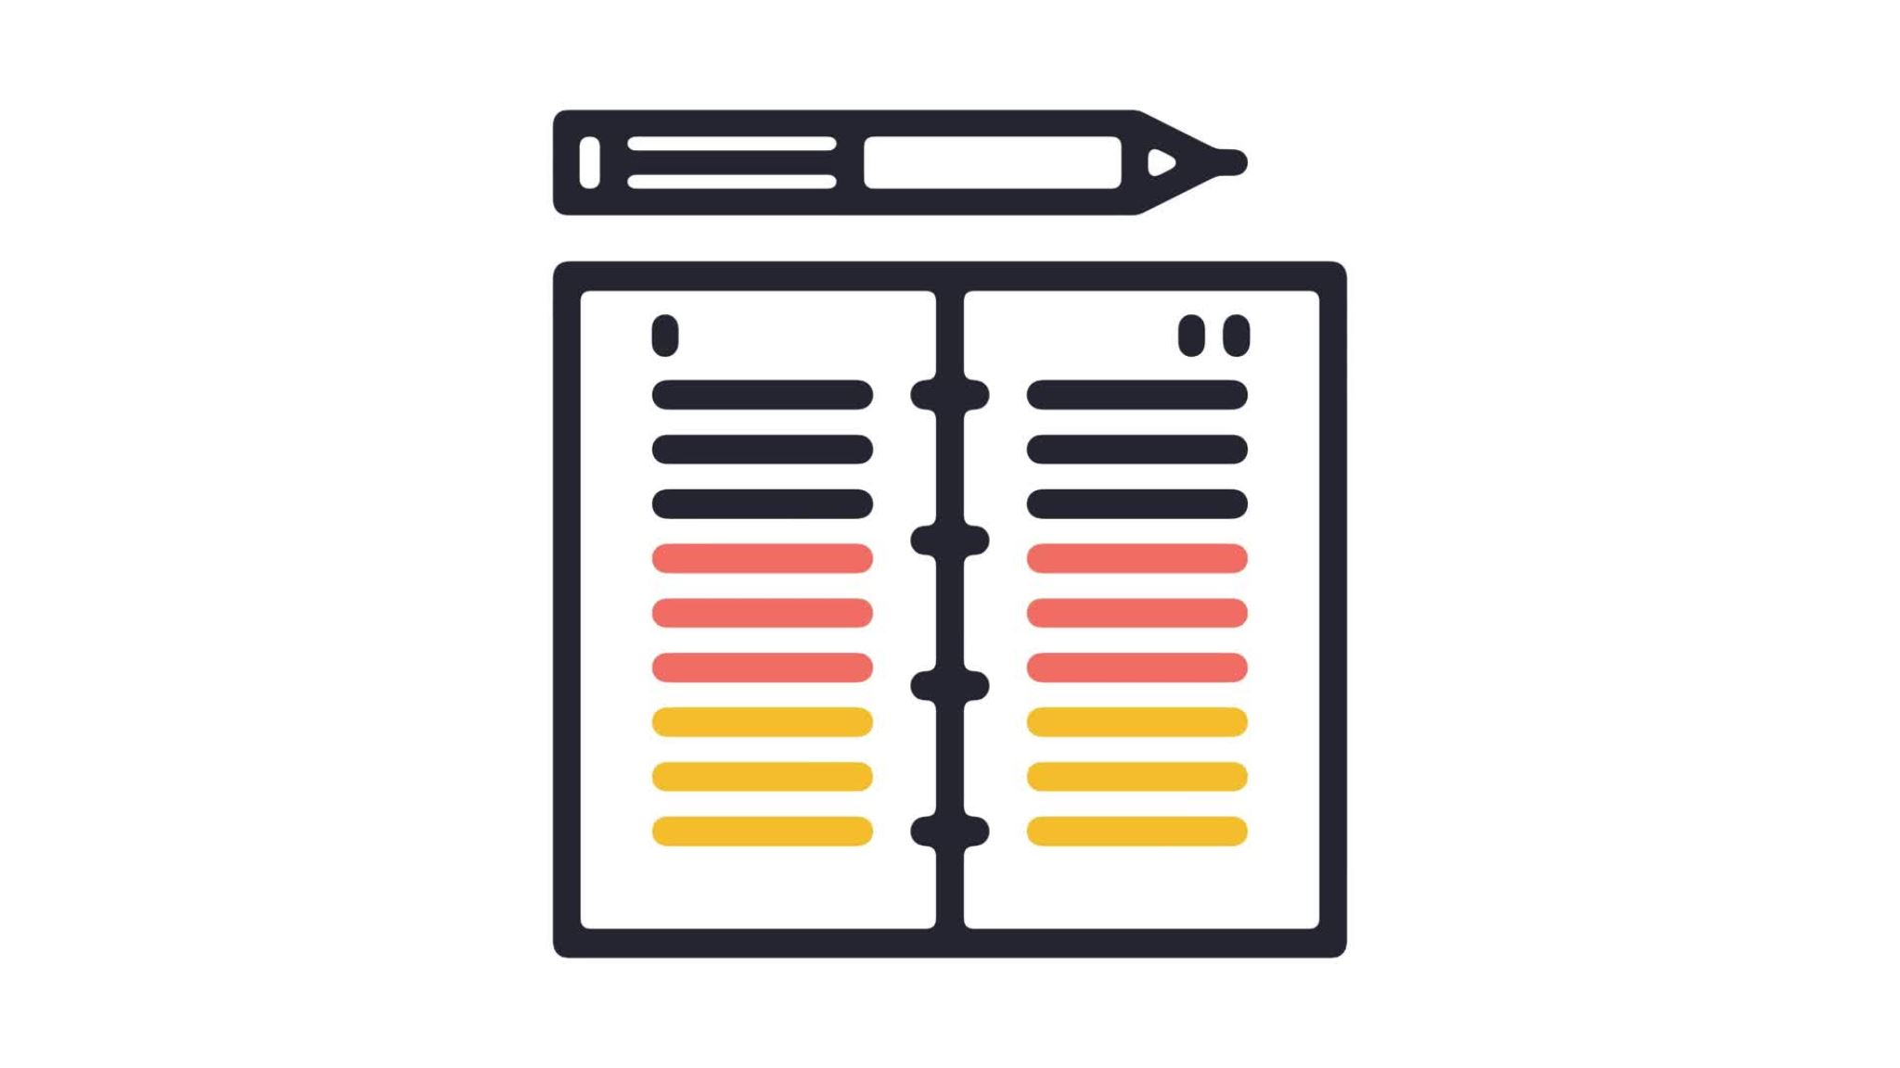
Design Document
Leo Ye

Slide 2






Manchester-LY
Welcome to the homepage
Manchester, sometimes abbreviated to MCR, is a major city in the northwest of England. The Bee symbolizes Manchester as it has been known for over 150 years. The city has seen approximately 2,791,000 visitors in 2023.
Click one of the buttons below to view four attractions in Manchester.
The Life of Pi
Christmas in Manchester
Events at Co-op Live
The Quays

Slide 3
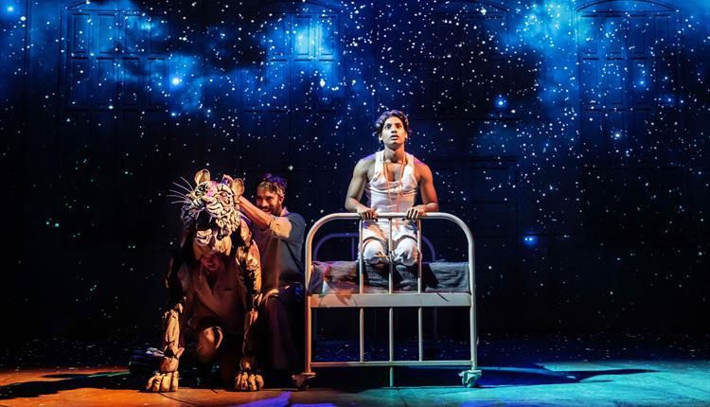
Manchester-LY
The Life of Pi
“Winner of every major play award including five Oliviers. The West End ‘theatrical phenomenon’ (Telegraph) embarks on its biggest journey yet. Jaw-dropping visuals, magic and world-class puppetry, combine in a unique and ‘breath-taking’ ”…
Find out more

Slide 4
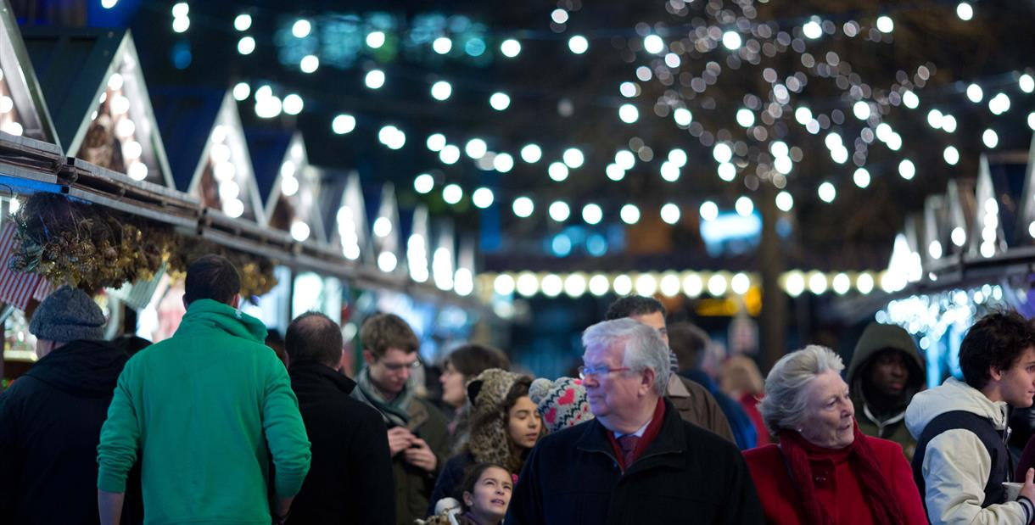
Manchester-LY
Christmas in Manchester
Discover about Christmas events taking place in Manchester.
There are further links that are included to explore.
Find out more

Slide 5
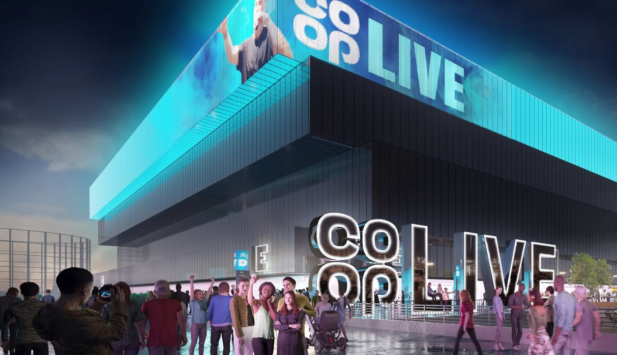
Manchester-LY
Events at Co-op Live
“Co-op Live, the UK’s largest live entertainment arena, is opening in April 2024 and gearing up for a huge opening season in Manchester, with 25 events already scheduled for Co-op Live’s opening month”…
Find out more

Slide 6
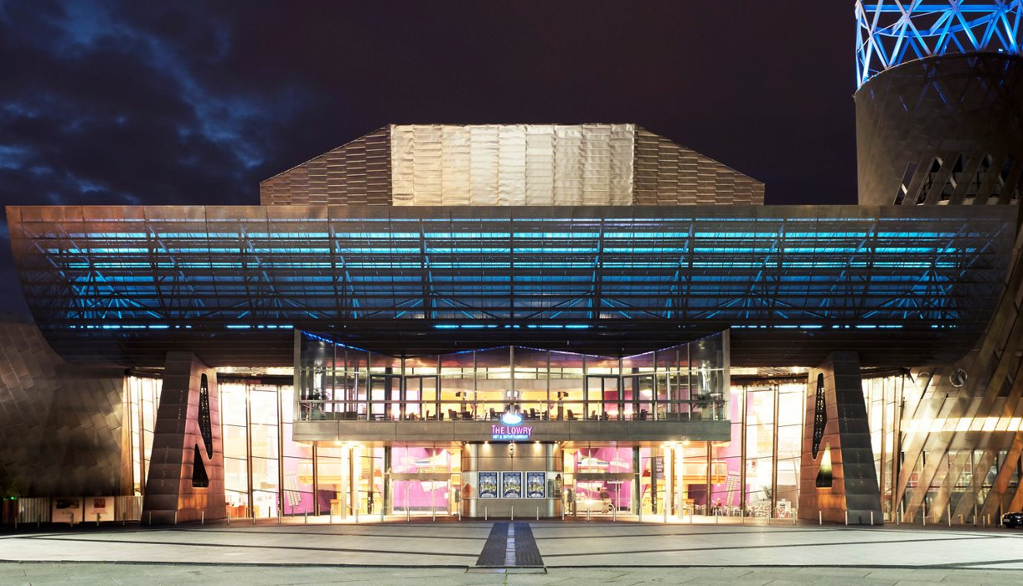
Manchester-LY
The Quays
Discover The Quays, formerly called Salford Quays, which includes landmarks such as the Imperial War Museum and Quayside MediaCityUK, formerly named The Lowry Outlet.
Find out more

Slide 7
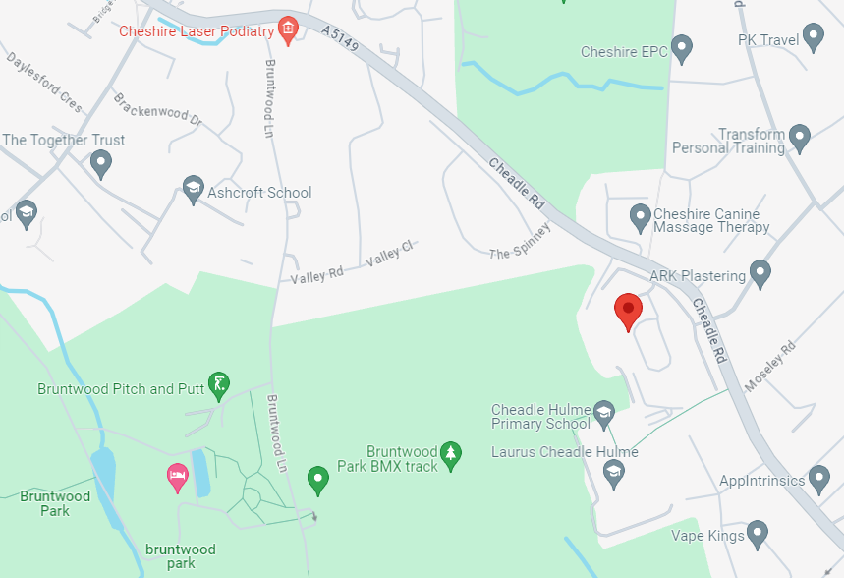

Manchester-LY
Contact us
Email: 2307454@cheadle.tcg.ac.uk
Form: Map:
Open location on Google Maps

Slide 8

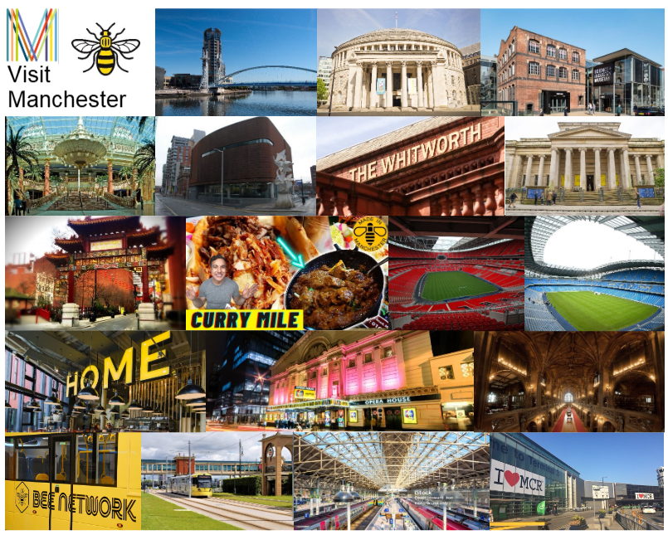
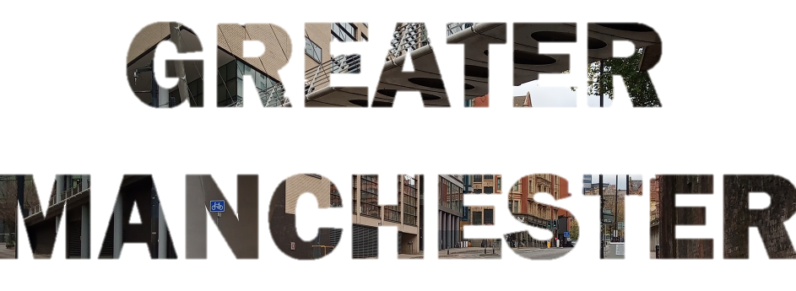
Manchester-LY
Moodboard
#

Slide 9
Manchester-LY
Storyboard
Homepage
Events/places
Contact us
Moodboard
Colour checker
Nav bar
Nav bar
Nav bar
Nav bar
Nav bar
Image
Imaged
text
Shape
Image
Image
Image
Heading
Heading
Image
Heading
Shape
Overview
Desc.
Email
Shape
Form
Map
Instruction
Link
Shape
Link
Button
Button
Button
Button
(4 pages)
Shape
List
Shapes
Link
Navigation bar is at top with website name on left and icon buttons on right leading to home, contact, moodboard, storyboard and colour checker.
Welcome heading is centred with overview of Manchester below. Instruction above buttons that lead to the event/places.
Below the navigation bar, heading of the event/place and a brief description/summary is on the left next to the image.
Below the text is a link to the event/place.
Below the navigation bar, the heading of ‘contact us’ is centred.
A link with the user email is included. Below, there is a form to fill out and an image of the map with the current location. There is a link below the map, although already included by clicking the image.
A collage of images from Manchester. Next to it on the right is the ‘Greater Manchester’ text printed from an image, rotated 90 degrees clockwise. Both have been pre-made for Unit 10. Around both elements, meeting at southeast, there are curved-corner shapes with combination of gradient colours. ‘Moodboard’ heading is centred on the navigation bar.
Merged image of three examples of colour combinations. Below is the link to the contrast checker website.
At the bottom of the page is a list of colour hex codes that are found all over the website of Manchester-LY.
Notes:
The colour of the navigation bar consists of a vertical gradient: #FF9933 to #FFC000 (top to bottom). The transparency has been set to half (50%) to make it stand out. The reason why this colour has been chosen for the navigation bar is because it symbolizes the colours of Manchester (e.g. the Bee Network). Furthermore, the colour has a wide contrast with the background colour. The moodboard has been filled with a collection of places in Manchester that people here will recognize, plus familiar colours from public transit.
The website logo, just like many other websites, is placed on the left in the navigation bar. The idea ‘Manchester-LY’ includes the name of our city and the user initials in capitals, followed by a hyphen before. The reason we thought about this name for the website is because we would have created an adverb, obviously it’s made-up and not a real word. Alternatively, we thought about naming it ‘Manchester.ly’ instead, but the ‘.ly’ domain means ‘Libya’, which is a foreign country.
There are five buttons on the right in the nav bar. From left to right, they lead to; the homepage, contact page, moodboard, storyboard and colour checker page. The buttons are icons consisting of a house, telephone, emoji inside a board, book inside a board and a colour palette. Instead of just text-based buttons, we simplified to space-saving icons.
We made the contact details separate on another page/slide so that everything on the homepage is not too cluttered. We included other things like a moodboard and storyboard, resulting in four extra pages (excluding the first slide). Speaking of which, on the storyboard (current slide), since the four event pages have the same layout, we decided to include the contact us page, moodboard and colour checker page onto the storyboard as well. There are links included on the homepage, the events, contact page and colour checker page for reference.
On the last slide, the colour checker page, you will be able to copy and paste hex codes to experiment with contrast checking via the link provided. Well, maybe not with PowerPoint slideshow. We’ve already included three examples of selected colour combinations chosen from this designed website.
For the last three slides; the moodboard, storyboard and colour checker page, you’ll notice that the heading is on the navigation bar instead. We decided to save space, and this also marks these specific pages to be additionally special. We’ve also included ALT text on all the images and video.
The website logo and introduction slide has the Calisto MT font. The rest is in Arial. For the ‘Greater Manchester’, given that it was created using Photoshop, we’re not sure what font it is in.

Slide 10
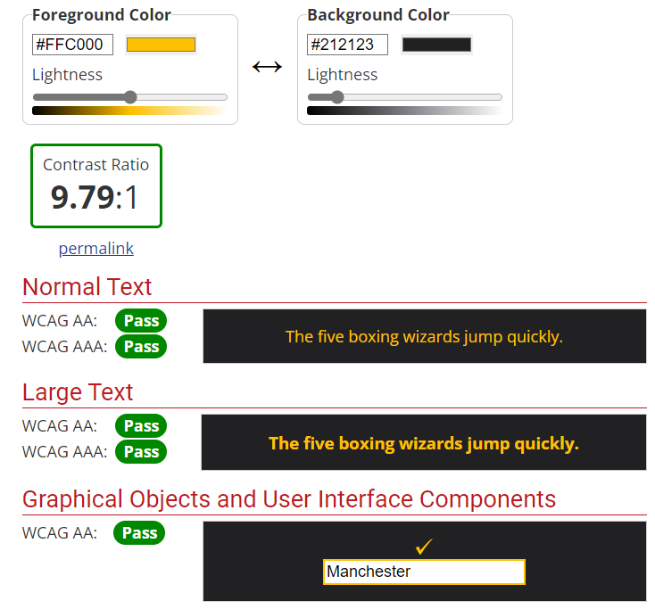
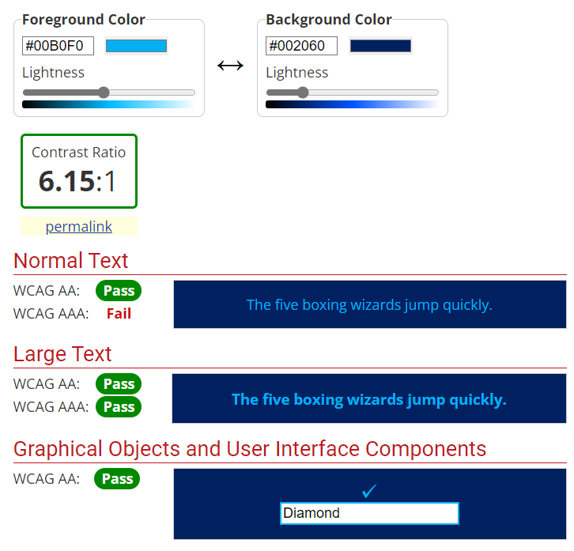
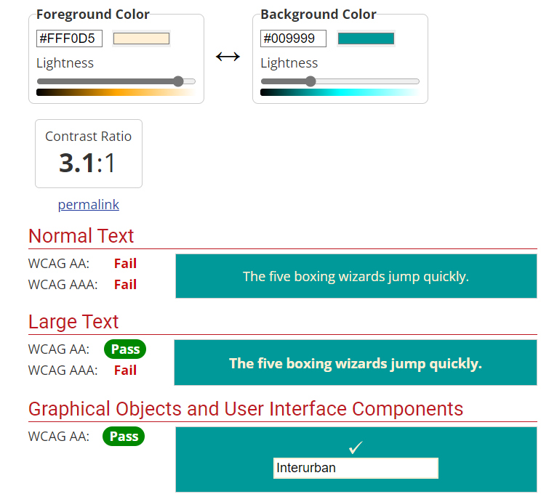
Manchester-LY
Colour checker
Try it yourself
Hexacode list: #FFC000, #2E2E30, #00B0F0, #002060, #FFF0D5, #009999, #FFFFFF, #00B050, #002060, #FF6600, #FF0000, #0000CC, #8D8D94, #54C5EC, #D9D9D9, #BFBFBF, #660033, #161616, #FF6600, #E98052

